Slide 1




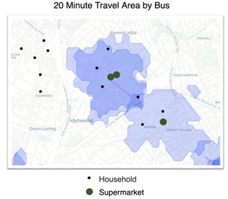
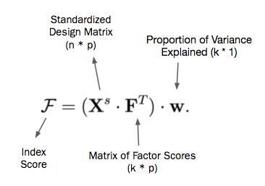
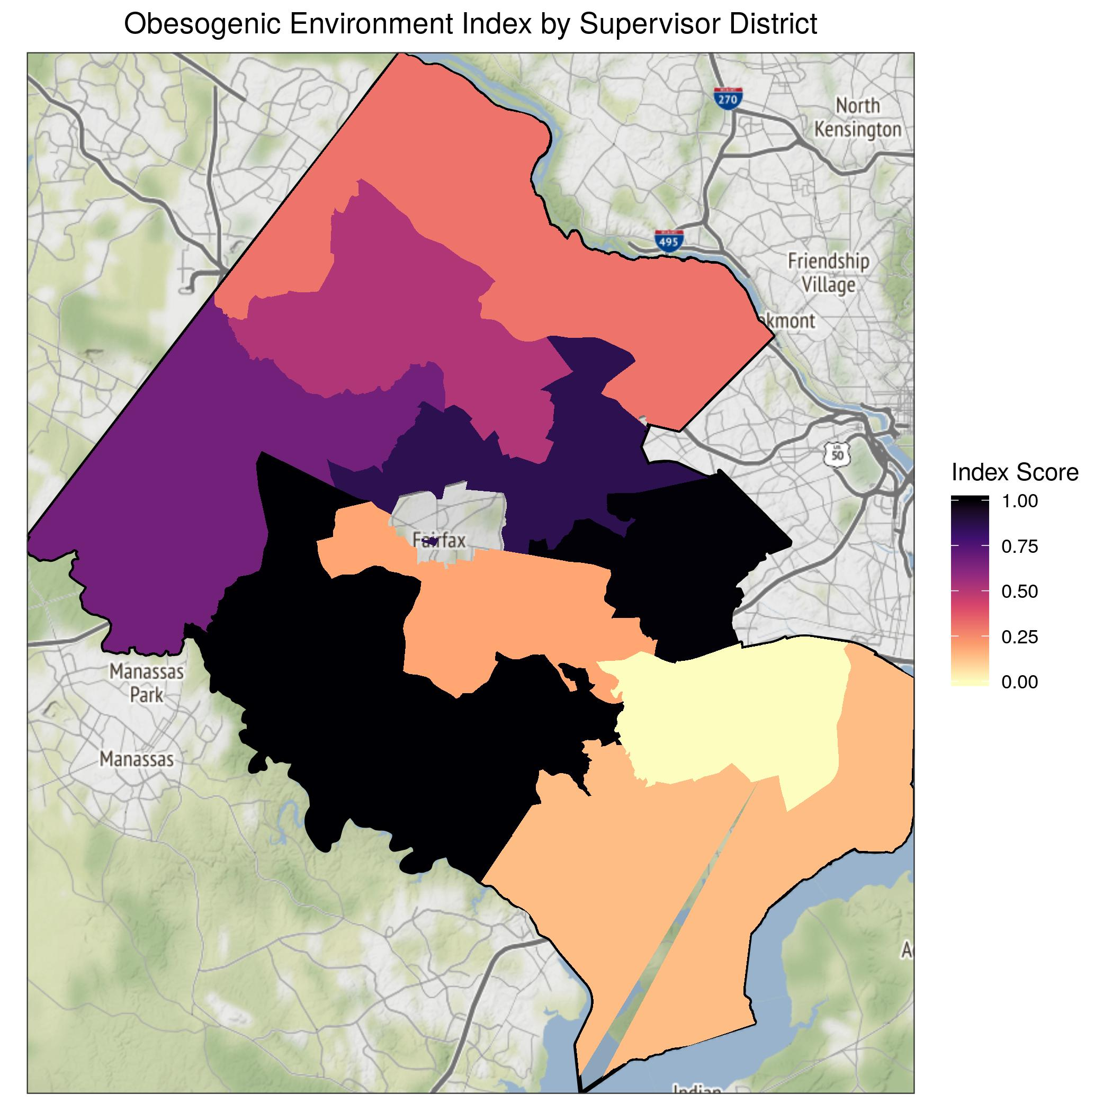
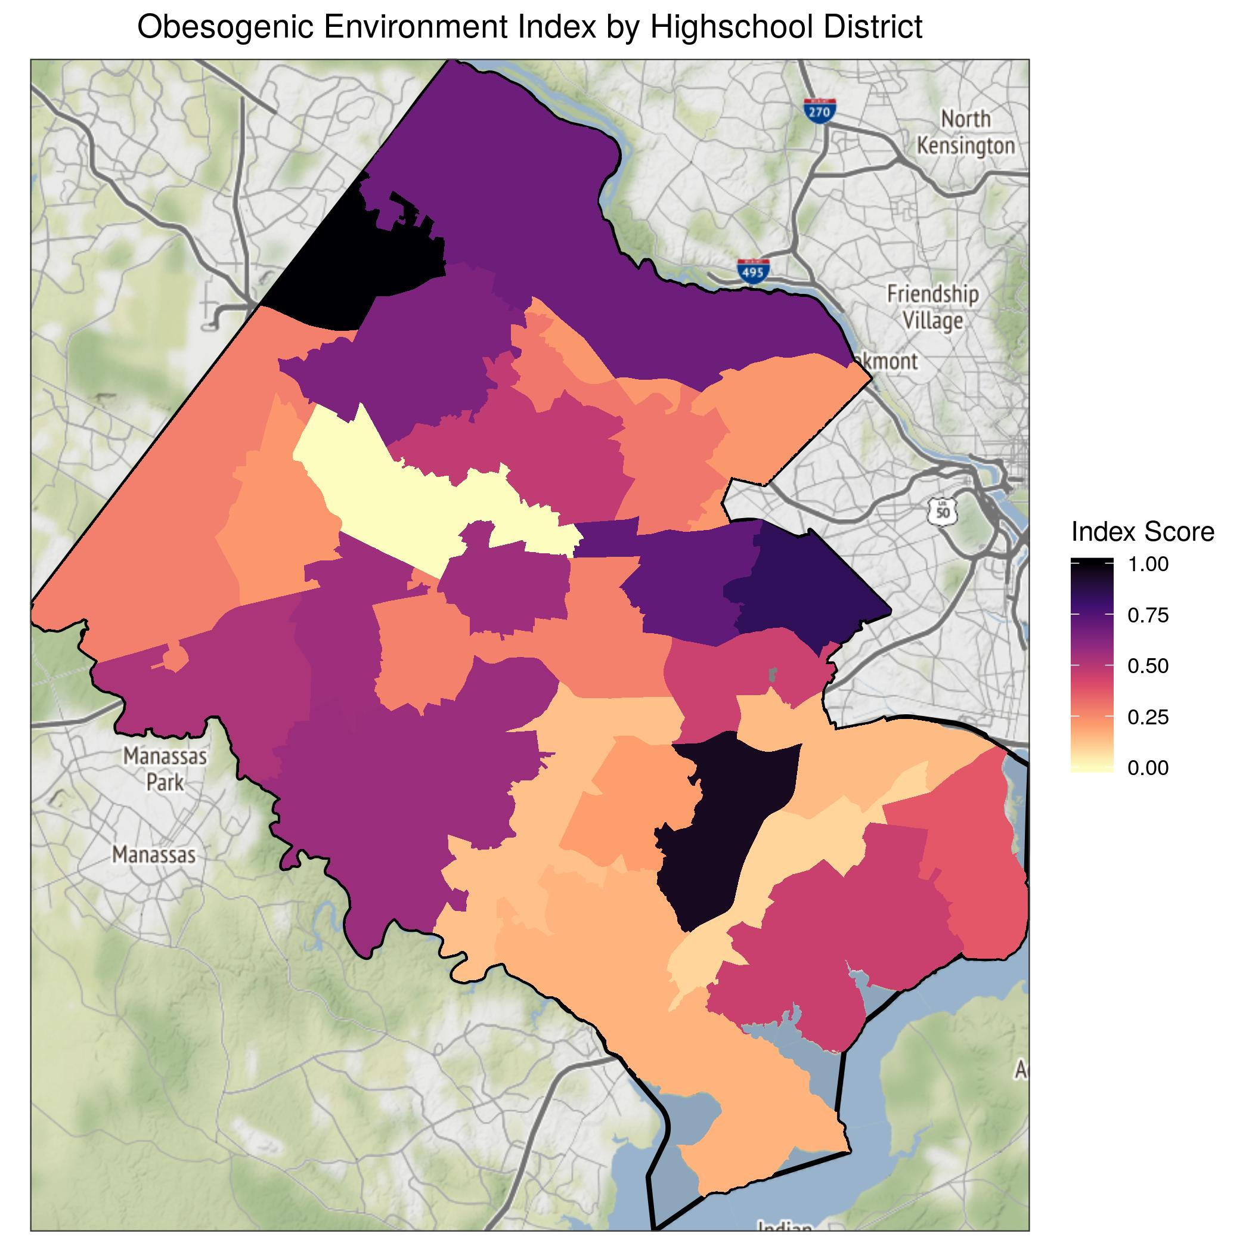
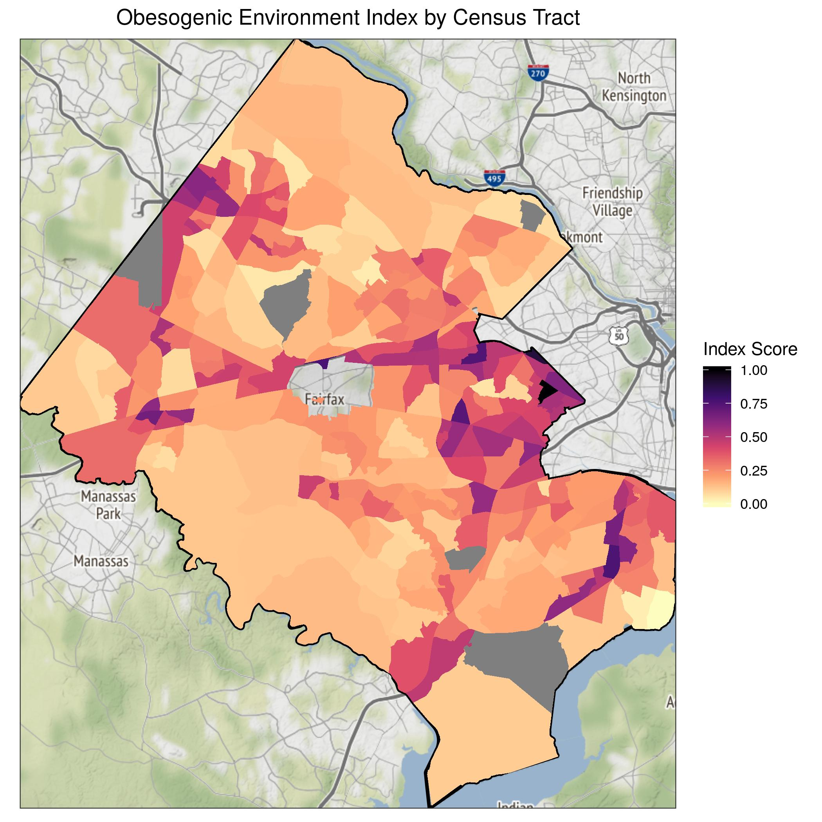

FAIRFAX COUNTY COMMUNITYSCAPE:
OBESOGENIC ENVIRONMENTS
DSPG Team: Cong Cong and Victoria Halewicz (University of Illinois at Urbana-Champaign), Quinton Neville (Columbia University), Eliza Tobin (University of Virginia)
SDAD Team: Teja Pristavec, Josh Goldstein, Brandon Kramer
Sponsor: Fairfax County and INOVA
Project Introduction
Framework
Project Description: Social determinants of health contribute to inequities across Fairfax County. This project aims to identify where vulnerable populations live, offering health officials and policymakers an actionable resource for resource allocation.
Social Determinants of Health
"The conditions... where people live, learn, work, and play" that "affect a wide range of health risks and outcomes." (Centers for Disease Control)​
Composite Index
SES
Explaining unobservable factors
with measurable variables
Objective: Create two composite indices—economic vulnerability and obesogenic environments—to quantitatively characterize the social determinants of health in Fairfax County.
Measurable Variables
Food
Obesogenic Environment
Obesogenic Environment
“The sum of influences that”
the social determinants of health have on promoting obesity in individuals or populations.” (Swinburn et al. 1999)
Phys.
Data Sources
Methods
OpenStreetMap (OSM): Geospatial locations of physical features
Variable Construction
Factor Analysis
Index Construction
American Community Survey (ACS): Demographics, Financial Conditions, Employment Status, Transportation, Synthetic Population.
1. ACS & Fairfax variable exploration → selection
2. ​Distance-time mutation from OSM data and travel-time isochrones
Restaurants
1. Standardize features
2. Factor loading weights
3. Proportions variance weights
4. Weighted sum score
5. Normalize score scale (0, 1)
Fast Food
0.9
0.9
Dimension 1:
Food Environment
Cronbach’s Alpha: 0.92
Gas Stations
0.7
0.8
Supermarkets
0.7
0.6
Alcohol Stores
Convenience Stores
Fairfax County Housing Stock: Domicile Locations​,
Housing Conditions​
Hispanic
No Insurance
Dimension 2: Social and Economic Status
Cronbach’s Alpha: 0.92
No High School
0.9
0.9
0.7
0.9
Poverty
0.5
Data Analysis
No Team Sport
Minority
Results
0.8
Dimension 3: Physical Environment
Cronbach’s Alpha: 0.82
Regions at high risk (darker color) of exposure to obesogenic environments:
Supervisor Districts: Springfield and Mason.
High School Districts: Herndon and Lee.
Census Tracts: Arlington and Dulles Airport adjacent.
No Swimming Pool
0.7
No Playground
0.7
Limitations
Conclusions
Next Steps
Quality of OSM data
Quality of TravelTime API
Citizenship unaccounted for in ACS
Index Weights
Index Validation
Interdisciplinary method for index construction provides new measurement for health inequities
Poor racial and ethnic minority groups have the highest risk, especially Hispanics
Policy intervention and resource allocation requires analysis at multiple geographic units
Overlaying findings with INOVA healthcare data
Addition of INOVA 1000 Days of Life data
Sensitivity analysis (robustness of index)
Compare current policy initiatives with maps to enhance existing measures and to create effective, evidence-based policy
Resources
Centers for Disease Control (2019). Social determinants of health. Available at https://www.cdc.gov/socialdeterminants/index.htm (7/31/2019).​
Swinburn, B., Egger, G., & Raza, F. (1999). Dissecting Obesogenic Environments: The Development and Application of a Framework for Identifying and Prioritizing Environmental Interventions for Obesity. Preventive Medicine, 29, 563-70. doi:10.1006/pmed.1999.0585​
Notes:
\item Standardize the variables
\item Take a weighted sum at each geographic observational unit for each Factor (where the weights are coming from the loadings in our factor analysis model) to obtain each Factor score.
\item Take a weighted sum of the Factor scores (where the weights are coming from the proportion of variance explained by each factor).
\item Normalize the results to a consistent (0, 1) scale.

